Slide 1


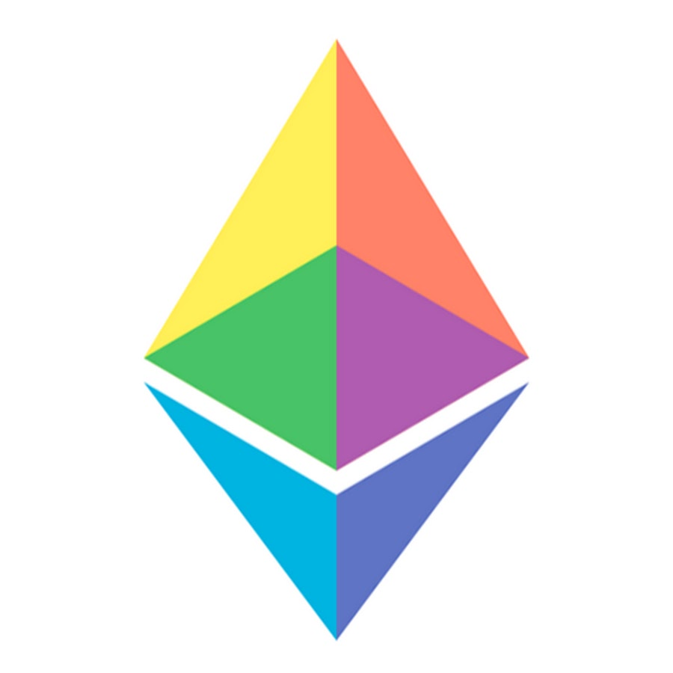
www.matematickaakademija.com

Slide 2
Content
Circom installation
Generating proofs with snarkjs
PLONK vs Groth16

Slide 3

Circom installation: macOS / Linux
1
Rust toolchain installs rustup + cargo, then open a new terminal
curl --proto '=https' --tlsv1.2 https://sh.rustup.rs -sSf | sh
2
Clone circom
git clone https://github.com/iden3/circom.git
3
Build & install takes a few minutes
cd circom && cargo build --release && cargo install --path circom
4
snarkjs JavaScript library, needs Node.js
npm install -g snarkjs
5
Check
circom --help
Needs Node.js, git and a C compiler (macOS: xcode-select --install, Linux: build-essential). Full guide

Slide 4
Circom installation: Windows
1
Rust toolchain download and run rustup-init.exe, accept Visual Studio C++ Build Tools
https://rustup.rs
2
Install circom downloads, builds and installs, no clone needed
cargo install --locked --git https://github.com/iden3/circom circom
3
snarkjs JavaScript library, needs Node.js
npm install -g snarkjs
4
Check in a new PowerShell window
circom --help
5
Run .ps1 scripts Windows blocks them by default
powershell -ExecutionPolicy Bypass -File .\script-groth16.ps1
Run the commands in PowerShell. Full guide

Slide 5
Process of proving circuits
1
2
3
4
5
6
Write
Compile
Witness
Setup
Prove
Verify
circuit.circom
.r1cs .wasm
.sym
witness.wtns
.ptau → .zkey
verification_key
proof.json
public.json
true / false
verifier.sol
circom compiler + generated WASM
Circuit becomes a constraint system (R1CS). The WASM program computes the values of all signals from inputs.json.
snarkjs (Groth16 or PLONK)
Setup produces proving/verification keys. Prover uses .zkey + witness; verifier needs only the vkey and public signals.

Slide 6
Example: guess the number
template guessTheNumber() {
signal input number; // public
signal input solution; // private
signal input commit; // public
signal input salt; // private
signal output out;
component commit_calc = Poseidon(2);
commit_calc.inputs[0] <== solution;
commit_calc.inputs[1] <== salt;
commit === commit_calc.out;
component eq = IsEqual();
eq.in[0] <== number;
eq.in[1] <== solution;
out <== eq.out;
}
Idea
Secret number hidden behind a Poseidon commitment; prove whether a guess is right without revealing it.
Constraint
commit === Poseidon(solution, salt)
Output
out = 1 iff number == solution
Operators
<== assign + constrain
=== constrain only
<-- assign only (unsafe alone)
Also in circuit.circom: include poseidon + comparators from circomlib, component main {public [number, commit]}

Slide 7
Compile & compute the witness
1
Dependencies circomlib, snarkjs, poseidon-lite
npm install
2
Inputs computes the commitment, writes inputs.json
node generate-inputs.js
3
Compile .r1cs constraints · .wasm witness program · .sym signal names
circom circuit.circom --r1cs --wasm --sym --output artifacts
4
Witness run in artifacts/ → witness.wtns: values of all signals, stays private
node circuit_js/generate_witness.js circuit_js/circuit.wasm ../inputs.json witness.wtns

Slide 8
Trusted setup: powers of tau
Phase 1 · universal
Phase 2 · circuit-specific
Independent of the circuit, depends only on max size: 2^12 = 4096 constraints
Multi-party ceremony: secure if at least one contributor is honest
Can reuse a public ceremony (perpetual powers of tau)
Depends on circuit.r1cs, redo it every time the circuit changes
Needed only for Groth16
PLONK skips it: plonk setup uses the phase 1 file directly
snarkjs powersoftau
new → contribute → beacon
→ prepare phase2
snarkjs groth16 setup
→ snarkjs zkey contribute
snarkjs docs: github.com/iden3/snarkjs · perpetual powers of tau

Slide 9
Proving with Groth16
1
Setup circuit-specific, uses a public phase 1 file
snarkjs groth16 setup circuit.r1cs powersOfTau28_hez_final_12.ptau circuit_0000.zkey
2
Contribute phase 2 ceremony, asks for random text
snarkjs zkey contribute circuit_0000.zkey circuit_final.zkey --name="mihailo" -v
3
Verification key
snarkjs zkey export verificationkey circuit_final.zkey verification_key.json
4
Prove proof.json: only 3 curve points · public.json: [out, number, commit]
snarkjs groth16 prove circuit_final.zkey witness.wtns proof.json public.json
5
Verify prints OK! · on-chain: zkey export solidityverifier → verifier.sol
snarkjs groth16 verify verification_key.json public.json proof.json

Slide 10
Proving with PLONK
1
Phase 1 our own ceremony: then contribute ×3, beacon, prepare phase2
snarkjs powersoftau new bn128 12 pot12_0000.ptau -v
2
Setup universal: no circuit-specific contribution
snarkjs plonk setup circuit.r1cs pot12_final.ptau circuit_final.zkey
3
Verification key
snarkjs zkey export verificationkey circuit_final.zkey verification_key.json
4
Prove proof.json: 9 curve points + 6 field elements
snarkjs plonk prove circuit_final.zkey witness.wtns proof.json public.json
5
Verify prints OK! · on-chain: zkey export solidityverifier → verifier.sol
snarkjs plonk verify verification_key.json public.json proof.json

Slide 11
Proving in JavaScript
const { groth16 } = require("snarkjs"); // or plonk
const inputs = JSON.parse(readFileSync("inputs.json"));
const { proof, publicSignals } = await groth16.fullProve(
inputs,
"./artifacts-groth16/circuit_js/circuit.wasm",
"./artifacts-groth16/circuit_final.zkey");
const vKey = JSON.parse(
readFileSync("./artifacts-groth16/verification_key.json"));
const ok = await groth16.verify(vKey, publicSignals, proof);
console.log(ok ? "Verification OK" : "Invalid proof");
fullProve
computes the witness and the proof in one step
Same API
plonk.fullProve / plonk.verify with the PLONK artifacts
Client-side
runs in the browser: private inputs never leave the user

Slide 12
PLONK vs Groth16
PLONK
Groth16
Trusted setup
universal (phase 1 only)
circuit specific (phase 1 + 2)
Proof size
bigger: 9 points + 6 field el.
smaller: 3 points
Proving time
longer
shorter
Verification
longer
shorter
New circuit
reuse the same .ptau
new phase 2 ceremony
Groth16: many proofs for the same circuit, performance critical. PLONK: many different circuits (arbitrary business logic) with reasonably fast performance.

Slide 13
Thank you!

